Slide 1

Chapter 2
The OSI Model and
the TCP/IP Protocol Suite
Objectives
Upon completion you will be able to:
Understand the architecture of the OSI model
Understand the layers of the OSI model and their functions
Understand the architecture of the TCP/IP Protocol Suite
Differentiate between the OSI model and the TCP/IP Suite
Differentiate between the three types of Internet addresses

Slide 2
2.1 The OSI Model
Established in 1947, the International Standards Organization (ISO) is a multinational body dedicated to worldwide agreement on international standards. An ISO standard that covers all aspects of network communications is the Open Systems Interconnection (OSI) model. It was first introduced in the late 1970s.
The topics discussed in this section include:
Layered Architecture
Peer-to-Peer Processes
Encapsulation

Slide 3

Note:
ISO is the organization.
OSI is the model

Slide 4
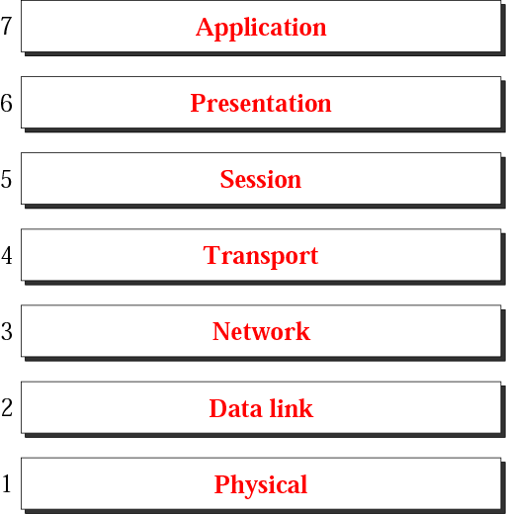
Figure 2.1 The OSI model

Slide 5
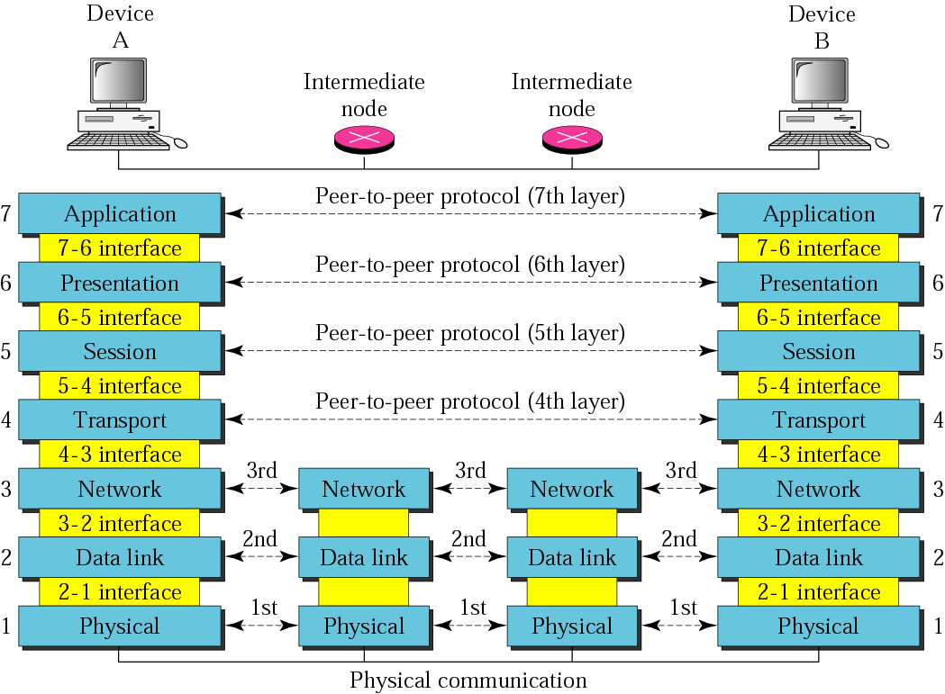
Figure 2.2 OSI layers

Slide 6
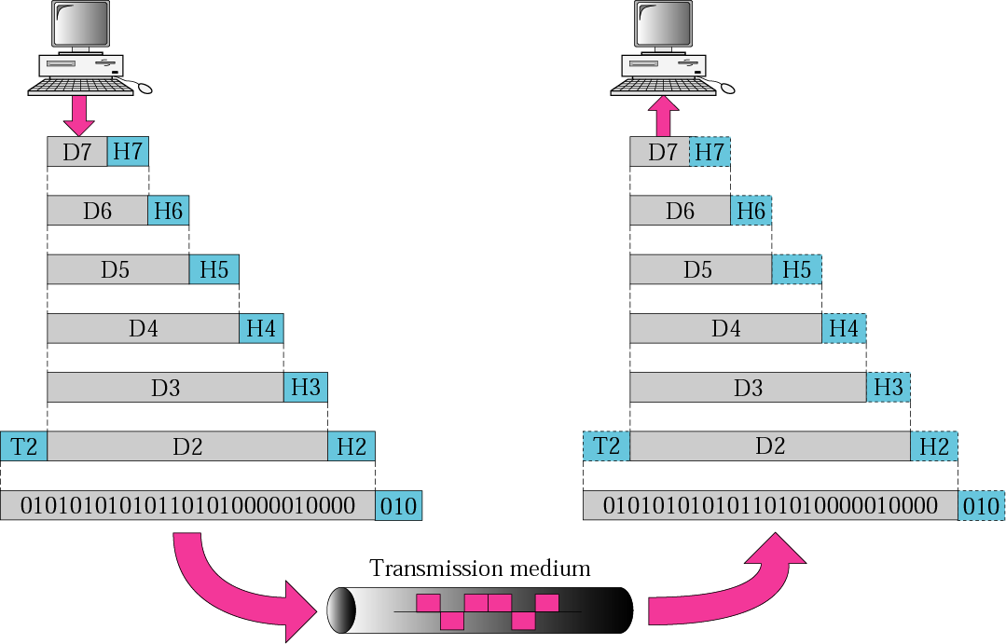
Figure 2.3 An exchange using the OSI model

Slide 7
2.2 Layers in the OSI Model
The functions of each layer in the OSI model is briefly described.
The topics discussed in this section include:
Physical Layer
Data Link Layer
Network Layer
Transport Layer
Session Layer
Presentation Layer
Application Layer
Summary of Layers

Slide 8
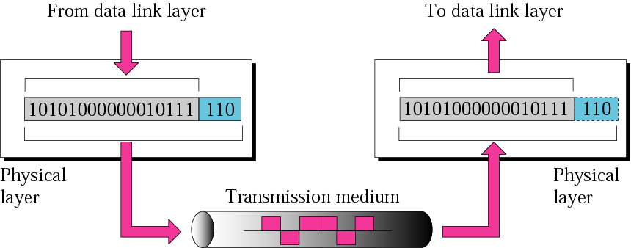
Figure 2.4 Physical layer

Slide 9
Note:
The physical layer is responsible
for the movement of individual bits from one hop (node) to the next.

Slide 10
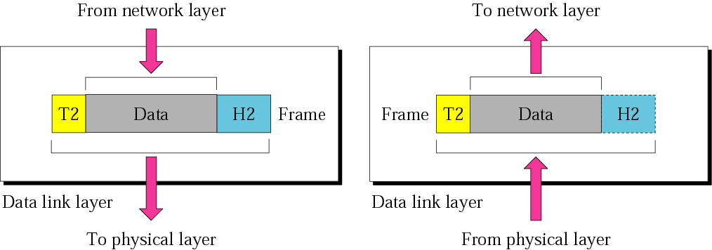
Figure 2.5 Data link layer

Slide 11
Note:
The data link layer is responsible for moving frames from one hop (node) to the next.

Slide 12
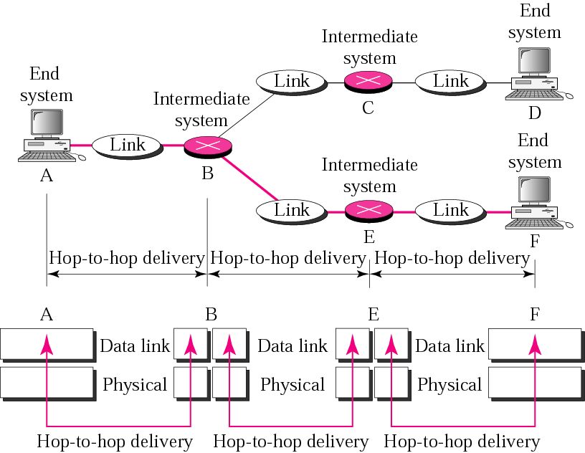
Figure 2.6 Hop-to-hop delivery

Slide 13
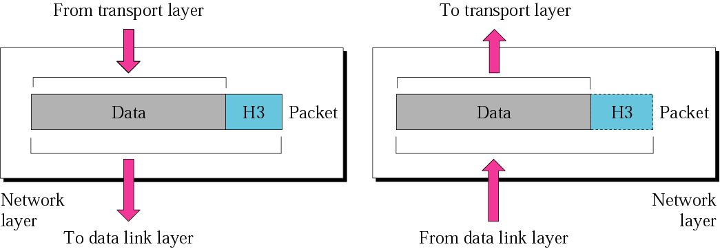
Figure 2.7 Network layer

Slide 14
Note:
The network layer is responsible for the delivery of individual packets from the source host to the destination host.

Slide 15
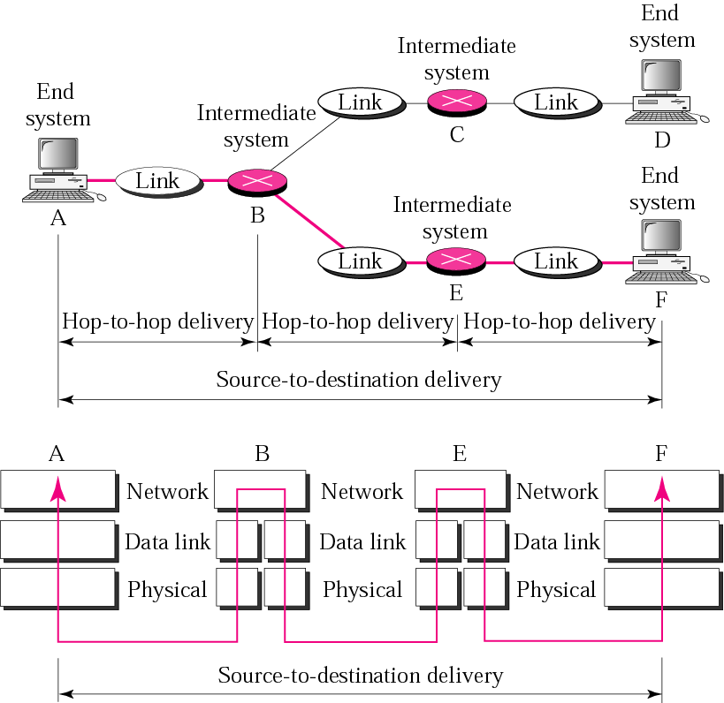
Figure 2.8 Source-to-destination delivery

Slide 16
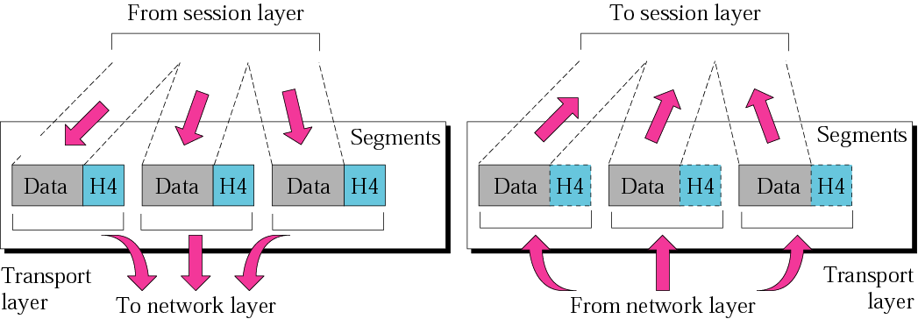
Figure 2.9 Transport layer

Slide 17
Note:
The transport layer is responsible for the delivery of a message from one process to another.

Slide 18
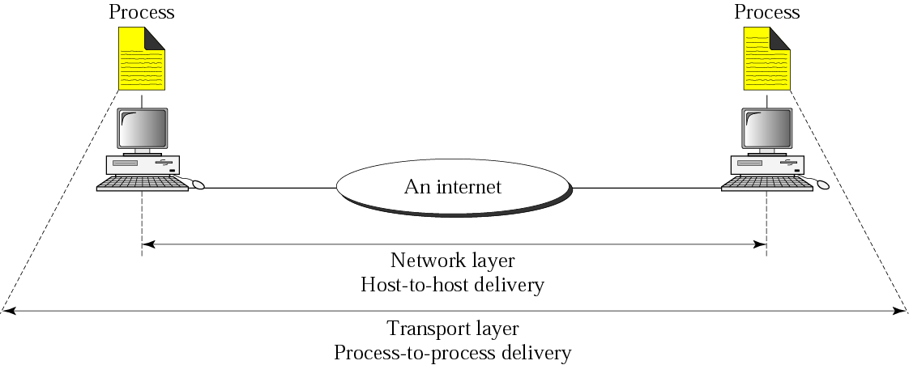
Figure 2.10 Reliable process-to-process delivery of a message

Slide 19
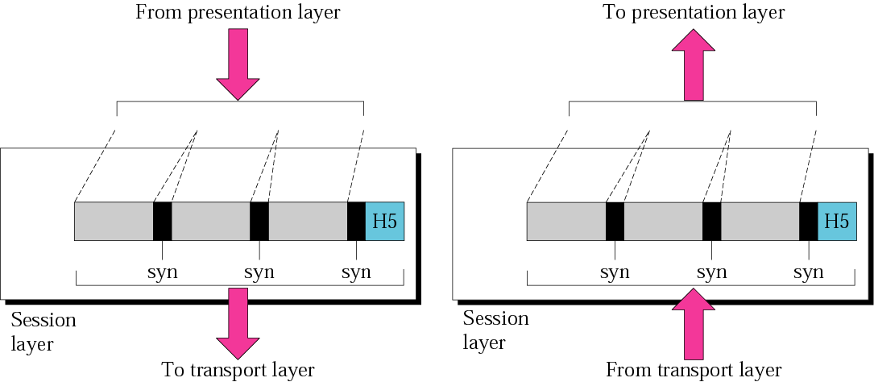
Figure 2.11 Session layer

Slide 20
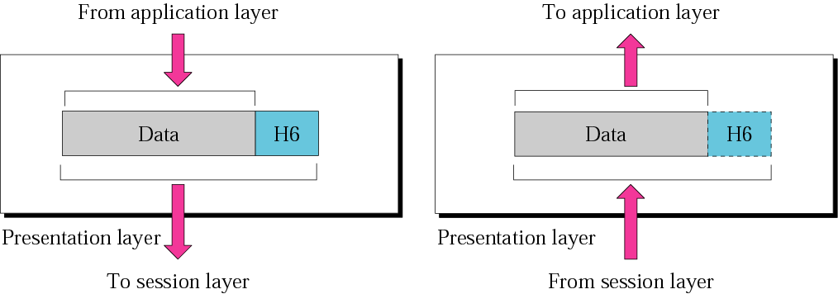
Figure 2.12 Presentation layer

Slide 21
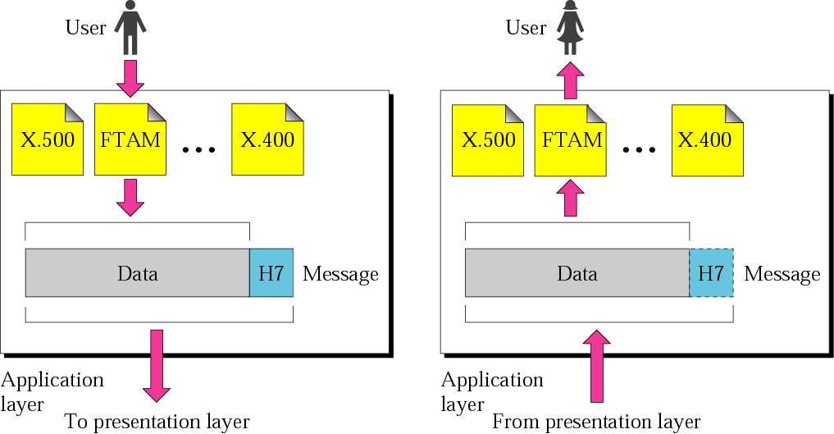
Figure 2.13 Application layer

Slide 22
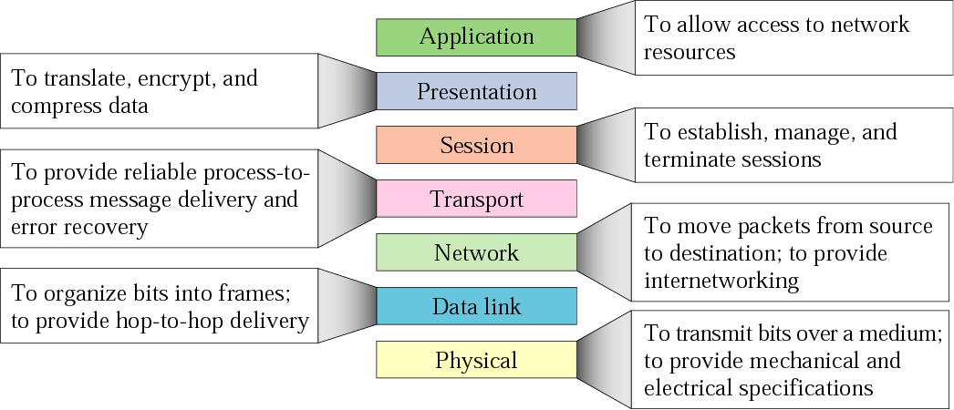
Figure 2.14 Summary of layers

Slide 23
2.3 TCP/IP Protocol Suite
The TCP/IP protocol suite is made of five layers: physical, data link, network, transport, and application. The first four layers provide physical standards, network interface, internetworking, and transport functions that correspond to the first four layers of the OSI model. The three topmost layers in the OSI model, however, are represented in TCP/IP by a single layer called the application layer.
The topics discussed in this section include:
Physical and Data Link Layers
Network Layer
Transport Layer
Application Layer

Slide 24
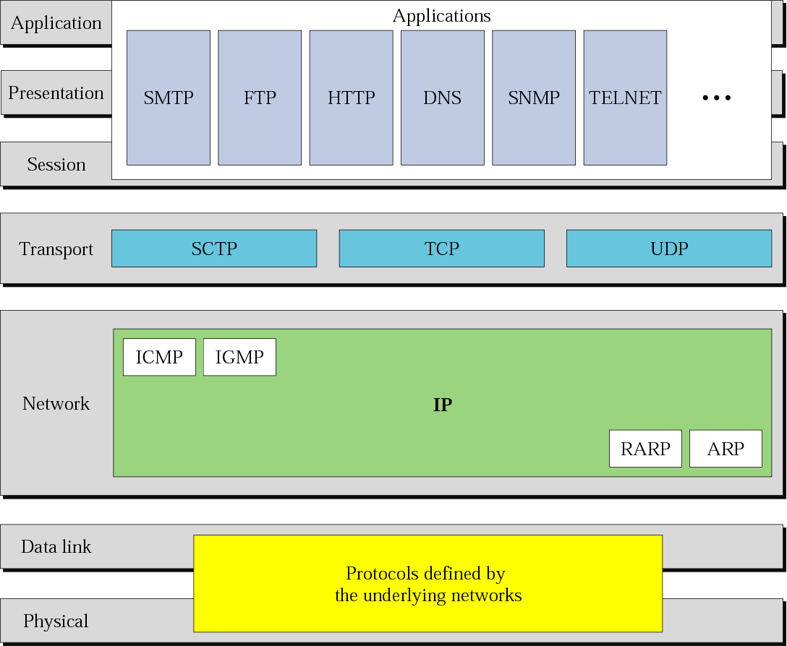
Figure 2.15 TCP/IP and OSI model

Slide 25
2.4 Addressing
Three different levels of addresses are used in an internet using the TCP/IP protocols: physical (link) address, logical (IP) address, and
port address.
The topics discussed in this section include:
Physical Address
Logical Address
Port Address

Slide 26
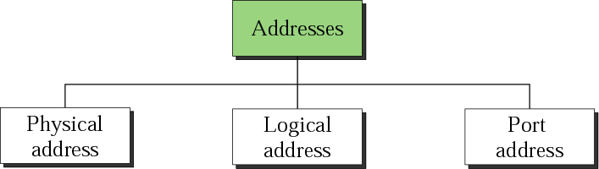
Figure 2.16 Addresses in TCP/IP

Slide 27
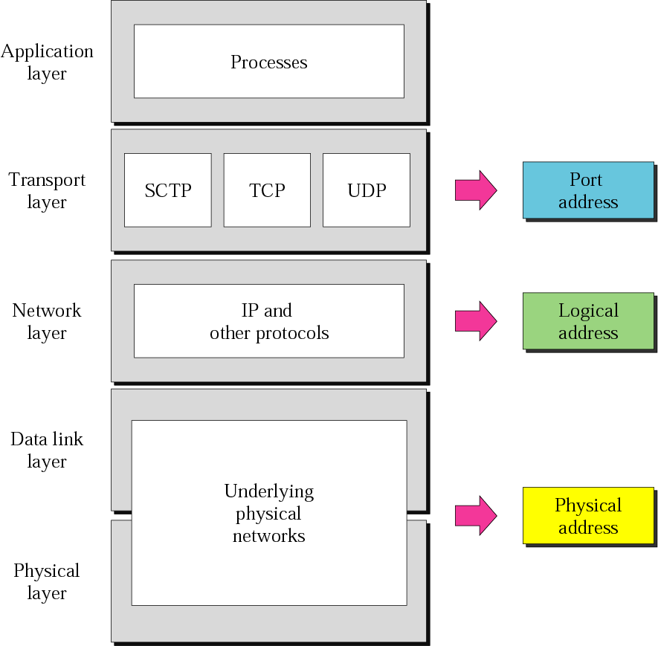
Figure 2.17 Relationship of layers and addresses in TCP/IP

Slide 28
Example 1
In Figure 2.18 a node with physical address 10 sends a frame to a node with physical address 87. The two nodes are connected by a link. At the data link level this frame contains physical (link) addresses in the header. These are the only addresses needed. The rest of the header contains other information needed at this level. The trailer usually contains extra bits needed for error detection.
See Next Slide

Slide 29
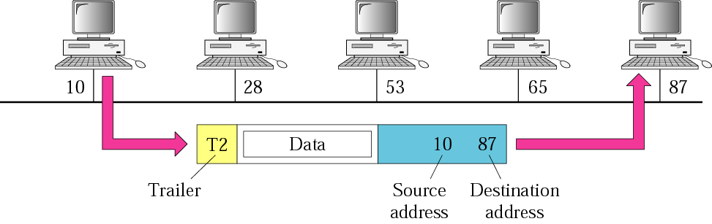
Figure 2.18 Physical addresses

Slide 30
Example 2
As we will see in Chapter 3, most local area networks use a 48-bit (6 bytes) physical address written as 12 hexadecimal digits, with every 2 bytes separated by a colon as shown below:
07:01:02:01:2C:4B
A 6-byte (12 hexadecimal digits) physical address.

Slide 31
Example 3
In Figure 2.19 we want to send data from a node with network address A and physical address 10, located on one LAN, to a node with a network address P and physical address 95, located on another LAN. Because the two devices are located on different networks, we cannot use link addresses only; the link addresses have only local jurisdiction. What we need here are universal addresses that can pass through the LAN boundaries. The network (logical) addresses have this characteristic.
See Next Slide

Slide 32
Example 3 (Continued)
The packet at the network layer contains the logical addresses, which remain the same from the original source to the final destination (A and P, respectively, in the figure). They will not change when we go from network to network. However, the physical addresses will change as the packet moves from one network to another. The boxes labeled routers are internetworking devices, which we will discuss in Chapter 3.
See Next Slide

Slide 33
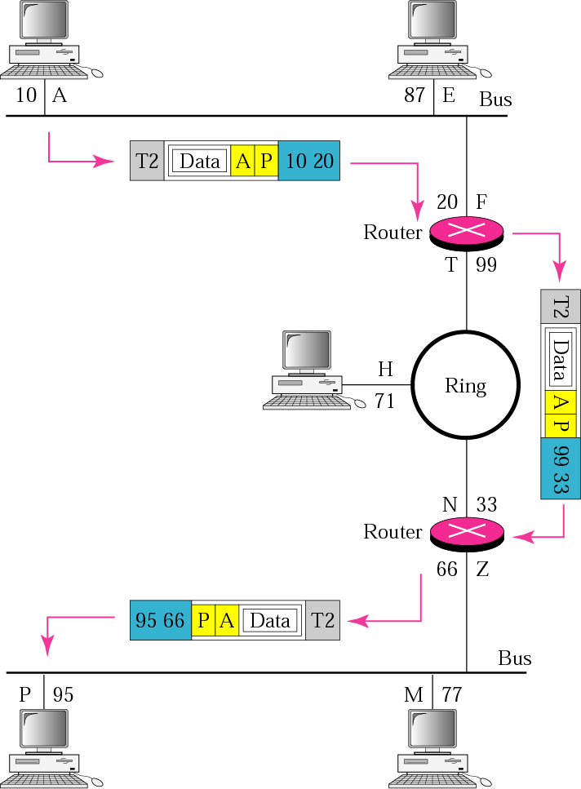
Figure 2.19 IP addresses

Slide 34
Example 4
As we will see in Chapter 4, an Internet address (in IPv4) is 32 bits in length, normally written as four decimal numbers, with each number representing 1 byte. The numbers are separated by a dot. Below is an example of such an address.
132.24.75.9
An internet address in IPv4 in decimal numbers

Slide 35
Example 5
Figure 2.20 shows an example of transport layer communication. Data coming from the upperlayers have port addresses j and k ( j is the address of the sending process, and k is the address of the receiving process). Since the data size is larger than the network layer can handle, the data are split into two packets, each packet retaining the service-point addresses ( j and k). Then in the network layer, network addresses (A and P) are added to each packet.
See Next Slide

Slide 36
Example 5 (Continued)
The packets can travel on different paths and arrive at the destination either in order or out of order. The two packets are delivered to the destination transport layer, which is responsible for removing the network layer headers and combining the two pieces of data for delivery to the upper layers.
See Next Slide

Slide 37
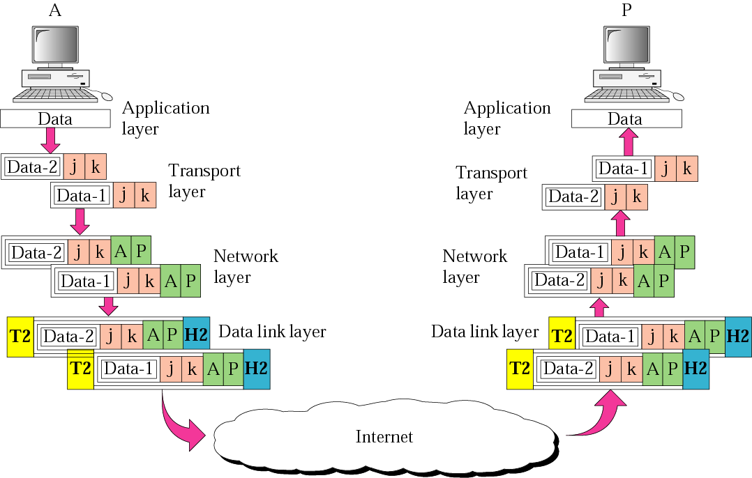
Figure 2.20 Port addresses

Slide 38
Example 6
As we will see in Chapters 11, 12, and 13, a port address is a 16-bit address represented by one decimal number as shown below.
753
A 16-bit port address represented as one single number.

Slide 39
2.5 IP Versions
IP became the official protocol for the Internet in 1983. As the Internet has evolved, so has IP. There have been six versions since its inception. We look at the latter three versions here.
The topics discussed in this section include:
Version 4
Version 5
Version 6

